Slide 2
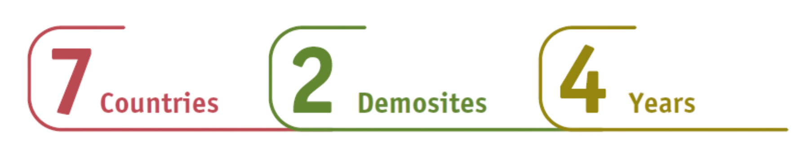
Project’s overview
JOULIA: Electrification of industrial processes using induction and microwaves technologies
Coordinator: CIRCE – CENTRO TECNOLOGICO (Spain)

Slide 3

About JOULIA​
JOULIA aims to accelerate the energy transition in the industrial sector with two innovative electric heating processes. The project will showcase induction and microwave heating technologies for rubber vulcanisation and glue activation in multilayer pipe production, optimised through digital models and process simulations.
With 16 partners across 7 EU countries, JOULIA will drive decarbonisation in energy-intensive and process industries, enhance sustainability, and strengthen industrial resilience and competitiveness.

Slide 4
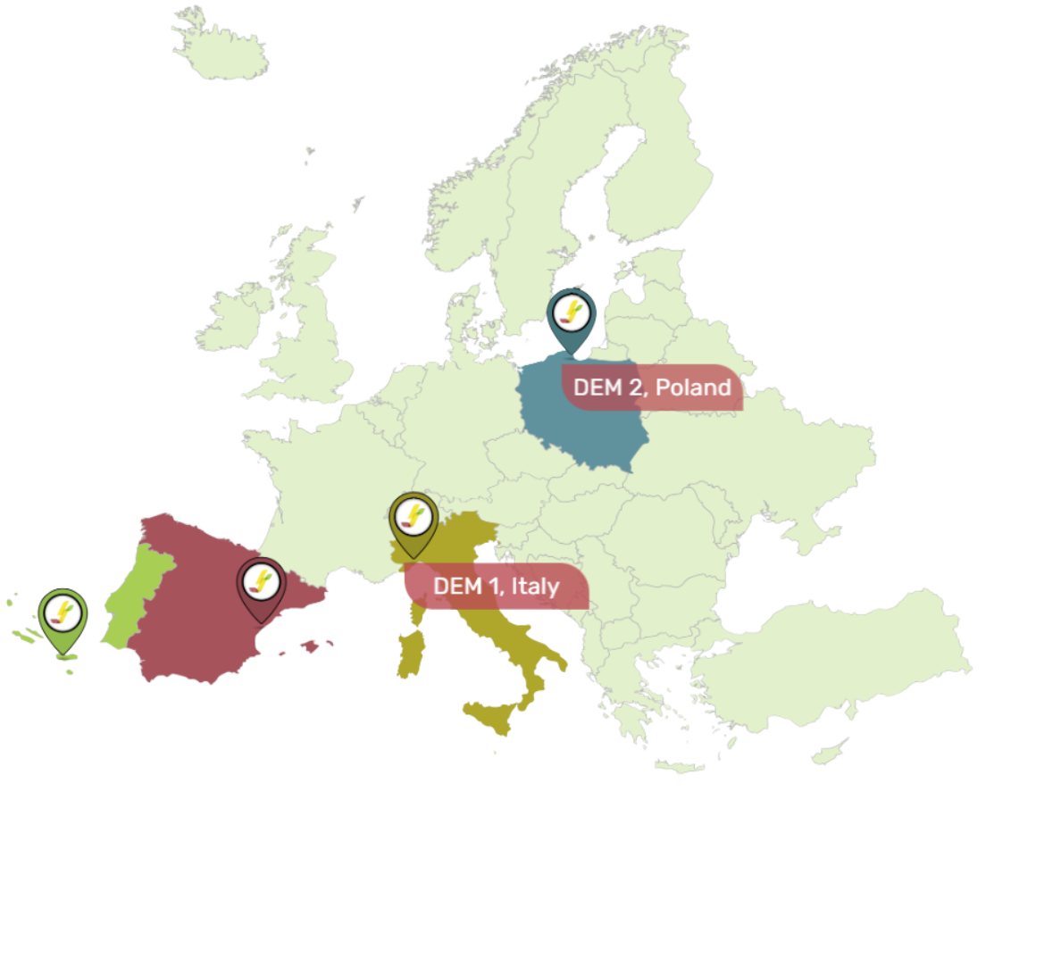
Demosites
At ART, JOULIA will retrofit a Rotary Curing Press (Rotocure) with induction heating, ensuring uniform heat distribution up to 220ºC, 500–700 kg/h production, and 25% lower energy consumption.
At K-FLEX, microwave heating will replace conventional adhesive activation in multilayer pipe production, enabling precise glue activation up to 100ºC and 40% energy savings.
Techno-economic studies, supported by ART and K-FLEX, will assess insulation rubber and rubber granule vulcanisation.

Slide 5
Replication Sites
JOULIA will conduct replication studies to evaluate their potential for industrial scale-up. These studies will include preliminary cost assessments, identify technical and regulatory barriers and explore the workforce requirements needed to implement these solutions effectively.
Food Sector:
Replication studies will focus on induction heating in animal feed production and microwave –assisted biscuit production, with support from FNC.
Ceramic Sector:
Replication studies will focus on thermal sintering of enamel via induction heating and grit particle coating via microwave, with TORRECID providing industrial support.

Slide 6




JOULIA Objectives and Targets
Induction heating process:
Design and develop an induction heating system applied to heating cylinders to replace steam and oil​
​
Ensure up to 220 ºC and 500-700 kg/h in the vulcanization process maintaining controllability, proving the reliability and uniform heat distribution​
​
Reduce primary energy consumption up to 25%​
​
Enable optimal coupling and control of PV with the induction heating system

Slide 7
JOULIA Objectives and Targets
Microwave heating process:​
Design and develop an alternate heating system based on Microwave for multilayer plastic pipes in continuous production​
​
Ensure up to 100 ºC in the pipe​
​
Reduce process energy consumption in 40%​
​
Enable flexible use of electricity, avoiding consumption during idle and real time adaptability to production rate

Slide 8







JOULIA Approach
Process characterisation and data gathering
  Manufacturing and integration of solutions
  Evaluation of impact and
  replication strategy
Key information about energy use, material properties, and process flexibility is collected at demonstration sites. Existing heating prototypes and market opportunities are analysed, and performance indicators are set to guide the project's progress.
The heating technologies are manufactured and tested in controlled settings to ensure performance, safety, and stability. Pre-industrial trials help refine the systems, while software tools are adjusted to support the processes. The technologies are then installed and integrated into operational environments.
The project's results are assessed to identify their impact, scalability, and potential for replication in other industries. Recommendations for market opportunities, funding, and future research are made. Key stakeholders are engaged to support the widespread adoption of the solutions, and business models are developed for commercialisation.
  Design and engineering of JOULIA solutions
  Demonstration at operational environments
Using data from Phase 1, detailed designs for induction and microwave heating solutions are created, along with the development of technical specifications. These efforts ensure alignment with end-user needs while also producing an alpha version of the JOULIA software tools.
The developed solutions are tested under real industrial conditions. Their performance is monitored to ensure they meet the defined indicators. A governing board oversees the demonstrations to address risks and optimise operations.

